Slide 1
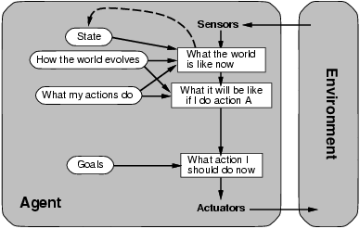
A Model-Based Agent
Requires: Knowledge and Reasoning

Slide 2
Knowledge and Reasoning
Knowledge and Reasoning:
humans are very good at acquiring new information by
combining raw knowledge, experience with reasoning.
AI-slogan: “Knowledge is power” (or “Data is power”?)
Examples:
Medical diagnosis --- physician diagnosing a patient
infers what disease, based on the knowledge he/she
acquired as a student, textbooks, prior cases
Common sense knowledge / reasoning ---
common everyday assumptions / inferences
e.g., “lecture starts at four” infer pm not am;
when traveling, I assume there is some way to get from the
airport to the hotel.

Slide 3
Logical agents:
Agents with some representation of the
complex knowledge about the world / its environment,
and uses inference to derive new information from that
knowledge combined with new inputs (e.g. via perception).
Key issues:
1- Representation of knowledge
What form? Meaning / semantics?
2- Reasoning and inference processes
Efficiency.

Slide 4
Knowledge-base Agents
Key issues:
Representation of knowledge → knowledge base
Reasoning processes → inference/reasoning
Knowledge base = set of sentences in a formal language representing facts about the world(*)
(*) called Knowledge Representation (KR) language

Slide 5

Knowledge bases
Key aspects:
How to add sentences to the knowledge base
How to query the knowledge base
Both tasks may involve inference – i.e. how to derive new sentences from old sentences
Logical agents – inference must obey the fundamental requirement that when one asks a question to the knowledge base, the answer should follow from what has been told to the knowledge base previously. (In other words the inference process should not “make things” up…)

Slide 6
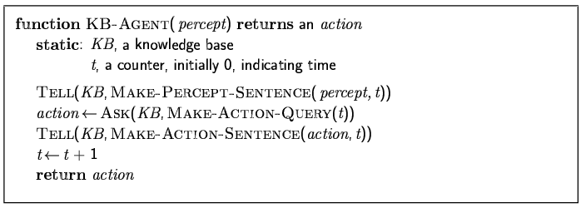
A simple knowledge-based agent
The agent must be able to:
Represent states, actions, etc.
Incorporate new percepts
Update internal representations of the world
Deduce hidden properties of the world
Deduce appropriate actions

Slide 7
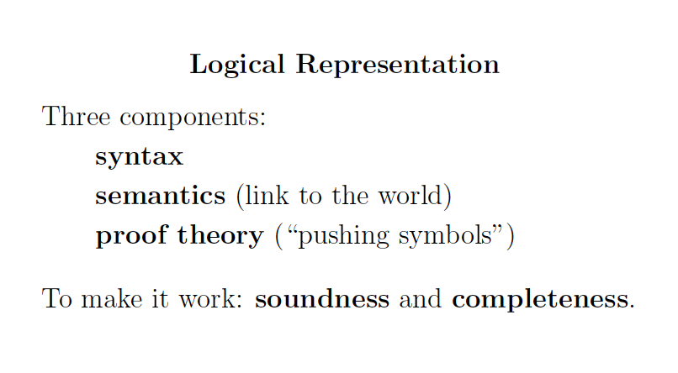

Slide 8
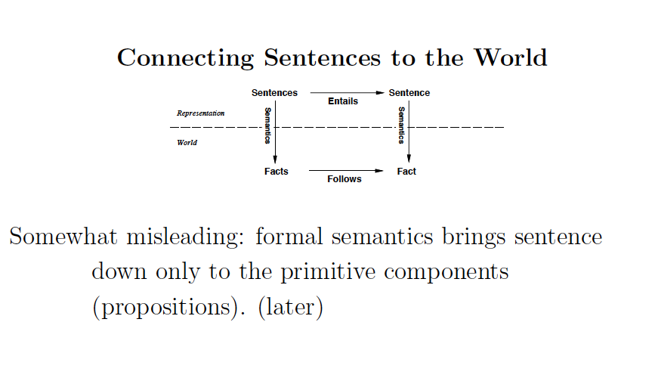

Slide 9
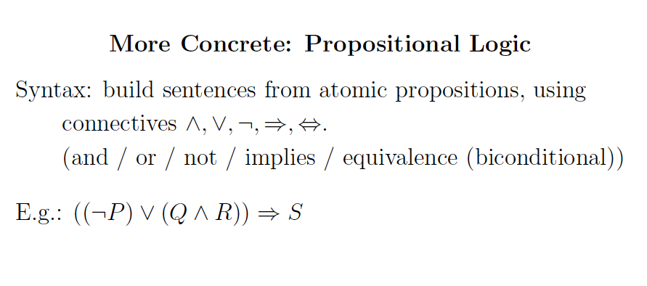

Slide 10
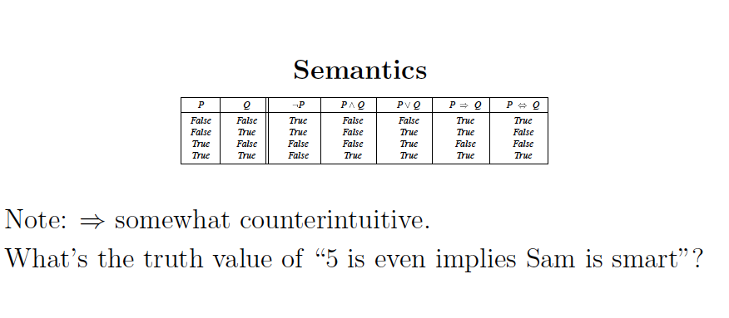

Slide 11
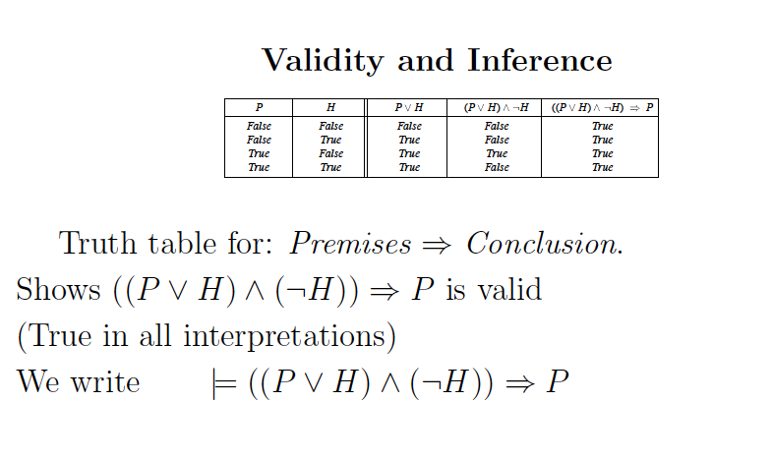

Slide 12
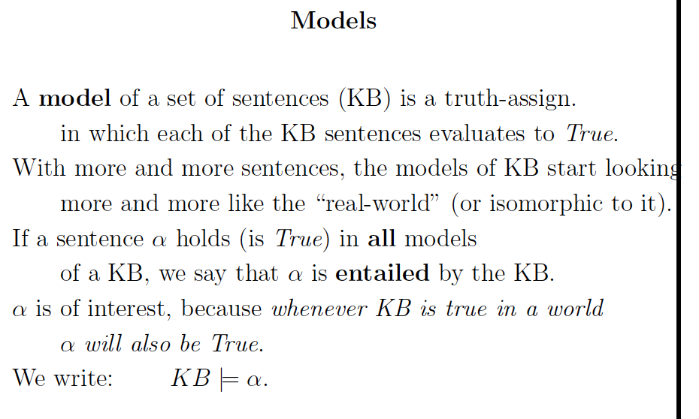
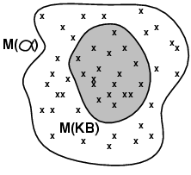
Note: KB defines exactly the set of worlds we are interested in.
I.e.: Models(KB) Models( )

Slide 13
Back to Knowledge-Based Agents…

Slide 14
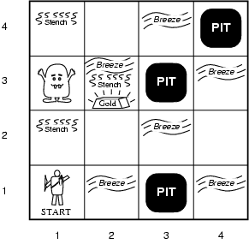
Illustrative example: Wumpus World
(Somewhat whimsical!)
Performance measure
gold +1000,
death -1000
(falling into a pit or being eaten by the wumpus)
-1 per step, -10 for using the arrow
Environment
Rooms / squares connected by doors.
Squares adjacent to wumpus are smelly
Squares adjacent to pit are breezy
Glitter iff gold is in the same square
Shooting kills wumpus if you are facing it
Shooting uses up the only arrow
Grabbing picks up gold if in same square
Releasing drops the gold in same square
Randomly generated at start of game. Wumpus only senses current room.
Sensors: Stench, Breeze, Glitter, Bump, Scream [perceptual inputs]
Actuators: Left turn, Right turn, Forward, Grab, Release, Shoot
Notes:
A cave consisting of rooms connected by passageways:
lurking somewhere in the cave is the wumpus, a beast that eats anyone who enters its room;
the wumpus can be shot by an agent, but the agent has only one arrow;
Some rooms contain bottomless pits that will trp anyone who wanders into these rooms – except the wumpus which is too big to fall;
Mitigating feature of living in this environment: finding gold (Michael Genesereth);
Agent always starts in square (1,1) facing to the right; locations of gold and the wumpus are chosen randomly, with uniform distribution, from the squares other than the start square; each square other than the start can be a pit with probability 0.2

Slide 15
Wumpus world characterization
Fully Observable No – only local perception
Deterministic Yes – outcomes exactly specified
Static Yes – Wumpus and Pits do not move
Discrete Yes
Single-agent? Yes – Wumpus is essentially a “natural feature.”

Slide 16
Exploring a wumpus world
The knowledge base of the agent
consists of the rules of the
Wumpus world plus the percept
“nothing” in [1,1]
Boolean percept
feature values:
<0, 0, 0, 0, 0>
None, none, none, none, none
Stench, Breeze, Glitter, Bump, Scream

Slide 17
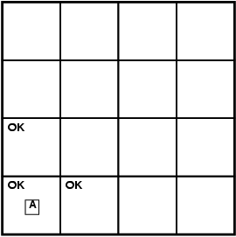
World “known” to agent
at time = 0.
T=0 The KB of the agent consists of
the rules of the Wumpus world plus
the percept “nothing” in [1,1].
By inference, the agent’s knowledge
base also has the information that
[2,1] and [1,2] are okay.
Added as propositions.
None, none, none, none, none
Stench, Breeze, Glitter, Bump, Scream

Slide 18
Further exploration
T = 0
T = 1
P?
A/B
P?
V
None, breeze, none, none, none
None, none, none, none, none
A – agent
V – visited
B - breeze
Stench, Breeze, Glitter, Bump, Scream
@ T = 1 What follows?
Pit(2,2) or Pit(3,1)
Where next?

Slide 19
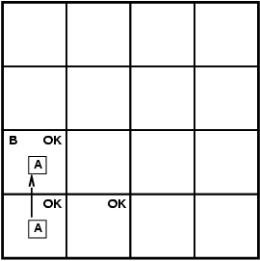
T=3
4
3
W
S
P?
S
2
P
1
P?
P
1 2 3 4
Stench, none, none, none, none
Stench, Breeze, Glitter, Bump, Scream
Where is Wumpus?
Wumpus cannot be in (1,1) or in (2,2) (Why?)➔ Wumpus in (1,3)
Not breeze in (1,2) ➔ no pit in (2,2); but we know there is
pit in (2,2) or (3,1) ➔ pit in (3,1)

Slide 20
We reasoned about the possible states the Wumpus world can be in, given our percepts and our knowledge of the rules of the Wumpus world.
I.e., the content of KB at T=3.
W
P
P
What follows is what holds true in all those worlds that satisfy what is known at that time T=3 about the particular Wumpus world we are in.
Example property: P_in_(3,1)
Models(KB) Models(P_in_(3,1))
Essence of logical reasoning:
Given all we know, Pit_in_(3,1) holds.
(“The world cannot be different.”)

Slide 21
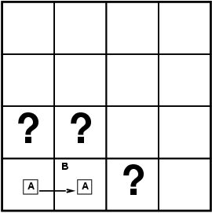
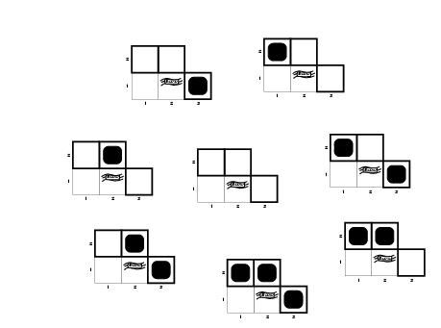
Formally: Entailment
Knowledge Base (KB) in the Wumpus World →
Rules of the wumpus world + new percepts
Situation after detecting nothing in [1,1], moving right, breeze in [2,1]. I.e. T=1.
Consider possible models for KB with respect to the cells (1,2), (2,2) and (3,1), with respect to the existence or non existence of pits
3 Boolean choices ⇒
8 possible interpretations
(enumerate all the models or
“possible worlds” wrt Pitt location)
T = 1

Slide 22
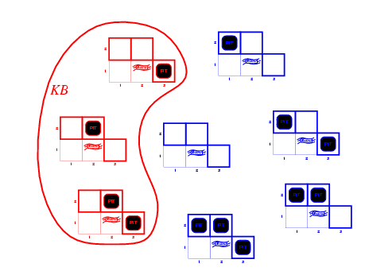

Is KB consistent with all
8 possible worlds?
Worlds
that violate KB
(are inconsistent
with what we
know)
KB = Wumpus-world rules + observations (T=1)
Q: Why does world violate KB?

Slide 23
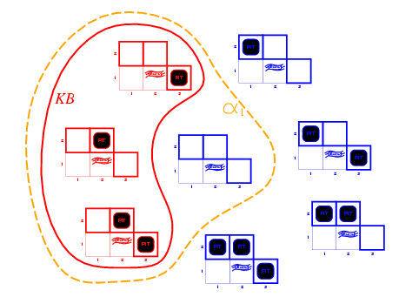
Entailment in Wumpus World
So, KB defines
all worlds that
we hold possible.
Queries: we want to know the properties of those worlds.
That’s how the semantics of logical entailment is defined.
Models of the KB and α1
Note: \alpha_1
holds in more
models than KB.
That’s OK, but we
don’t care about
those worlds.
KB = Wumpus-world rules + observations
α₁ = "[1,2] has no pit", KB ╞ α₁
In every model in which KB is true, α₁ is True (proved by “model checking”)

Slide 24
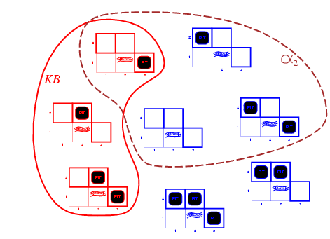
Wumpus models
KB = wumpus-world rules + observations
α2 = "[2,2] has no pit", this is only True in some
of the models for which KB is True, therefore KB ╞ α2
Model Checking
Models of α2
A model of KB where does NOT hold!
α2

Slide 25
Entailment via “Model Checking”
Inference by Model checking –
We enumerate all the KB models and check if α₁ and α₂ are
True in all the models (which implies that we can only use it
when we have a finite number of models).
I.e. using semantics directly.
Models(KB) Models( )

Slide 26
Wumpus World KB
Define propositions:
Let P_{i,j} be true if there is a pit in [i, j].
Let B_{i,j} be true if there is a breeze in [i, j].
Sentence 1 (R1): ¬ P_{1,1}
Sentence 2 (R2): ¬ B_{1,1}
Sentence 3 (R3): B_{2,1}
"Pits cause breezes in adjacent squares”
Sentence 4 (R4): B_{1,1} ⇔ (P_{1,2} ∨ P_{2,1})
Sentence 5 (R5): B_{2,1} ⇔ (P_{1,1} ∨ P_{2,2} ∨ P_{3,1})
etc.
Notes: (1) one such statement about Breeze for each square.
(2) similar statements about Wumpus, and stench
and Gold and glitter. (Need more propositional
letters.)
[Given.]
[Observation T = 0.]
[Observation T = 1.]

